Slide 1
Climate Change Science and the Limits of Confidence
John Nielsen-Gammon
Dept. of Atmospheric Sciences
Texas A&M University

Slide 2
97% of Climate Scientists agree:
The global climate has warmed over the past century
Humans are a major contributing factor
Impacts will be catastrophic unless we reduce or eliminate our use of fossil fuels

Slide 3
97% of Climate Scientists agree:
The global climate has warmed over the past century
Humans are a major contributing factor
Impacts will be catastrophic unless we reduce or eliminate our use of fossil fuels

Slide 4
Sources
Intergovernmental Panel on Climate Change
  Assessment Report #5
  Working Groups
    1: The Physical Science Basis
    2: Impacts, Adaptation, and Vulnerability
    3: Mitigation of Climate Change
IPCC AR5 WG1, etc.: http://ipcc.ch

Slide 5
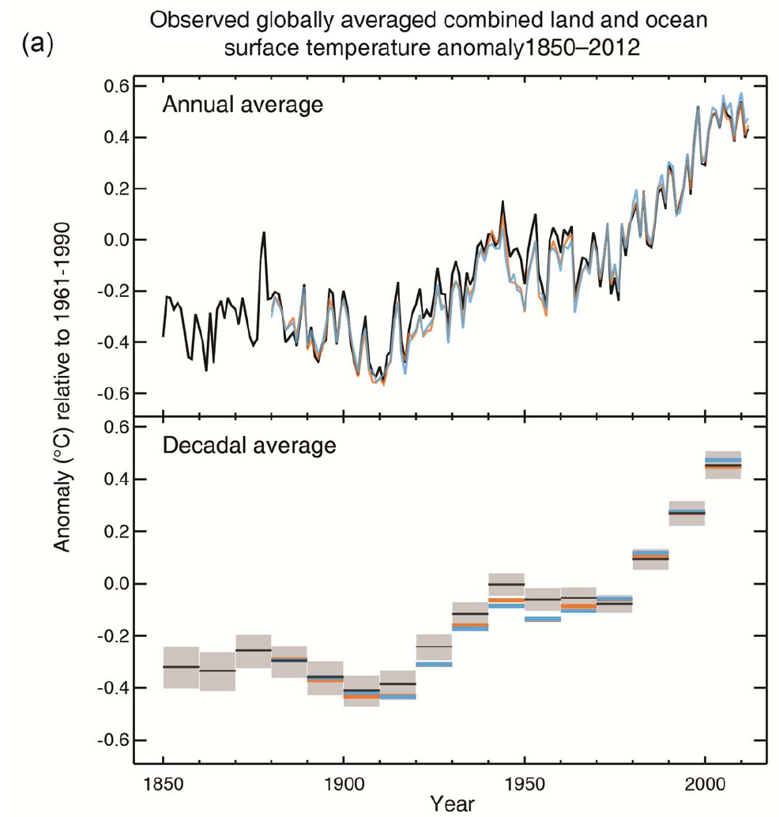
Global Surface Temperature

Slide 6
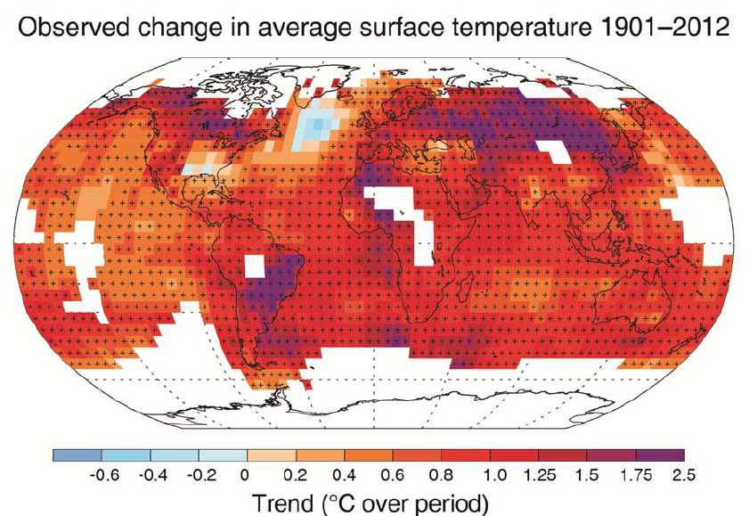
Pattern of Temperature Trend

Slide 7
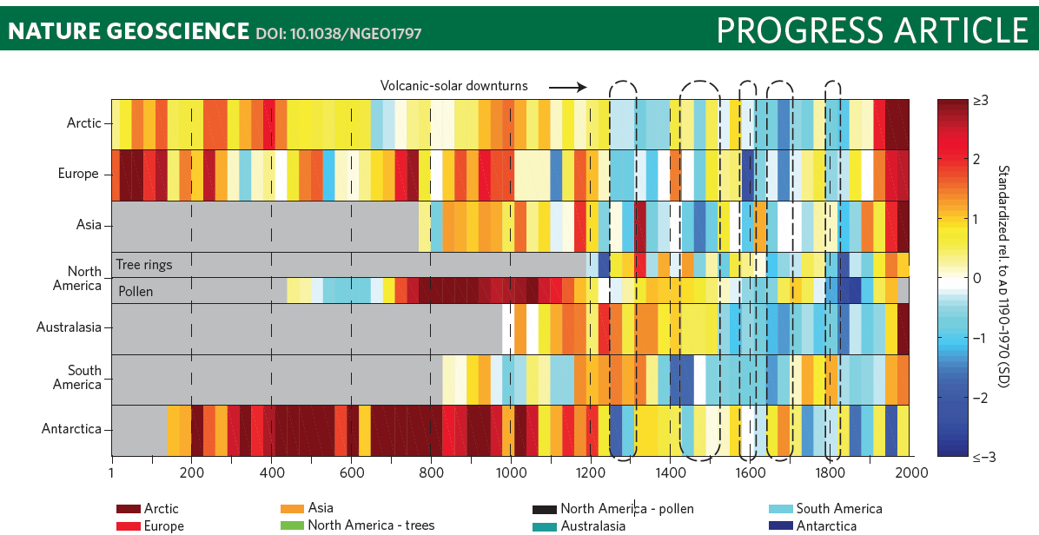
Regional Temperatures, 1-2000
(PAGES 2013)

Slide 8
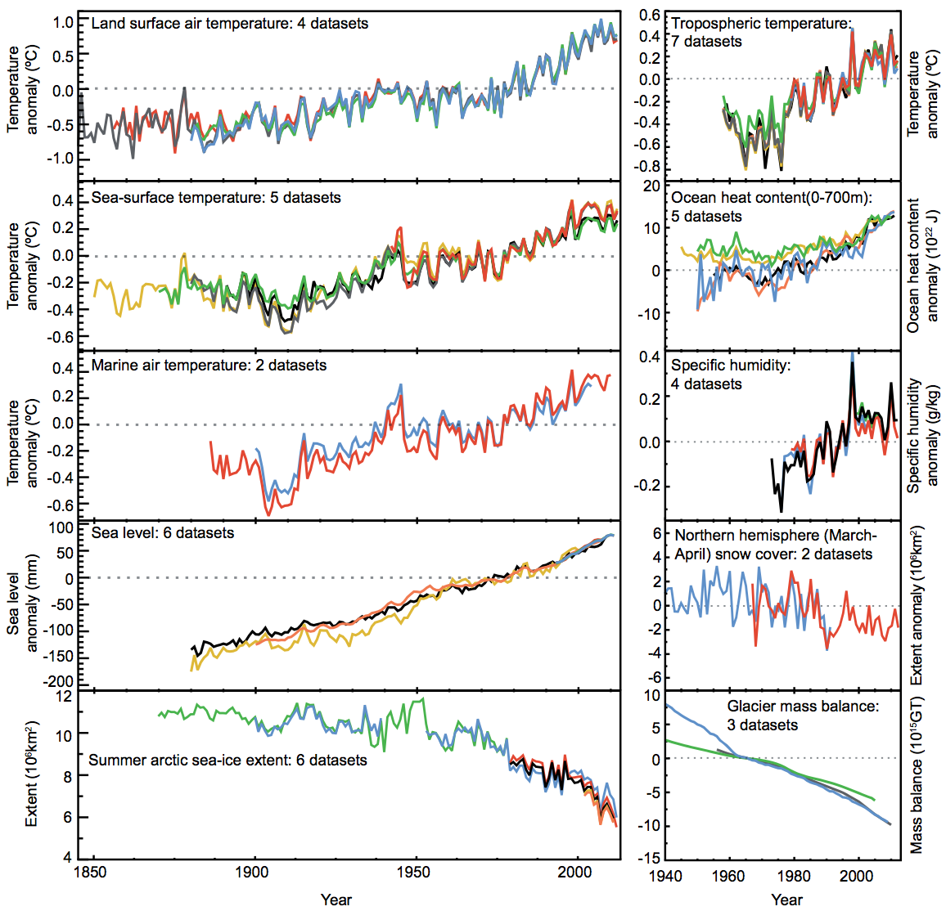
Multiple datasets & analyses
(AR5 WG1 FAQ2.1)

Slide 9
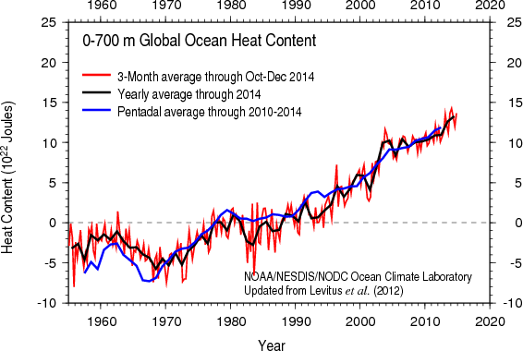
Energy gained by oceans

Slide 10
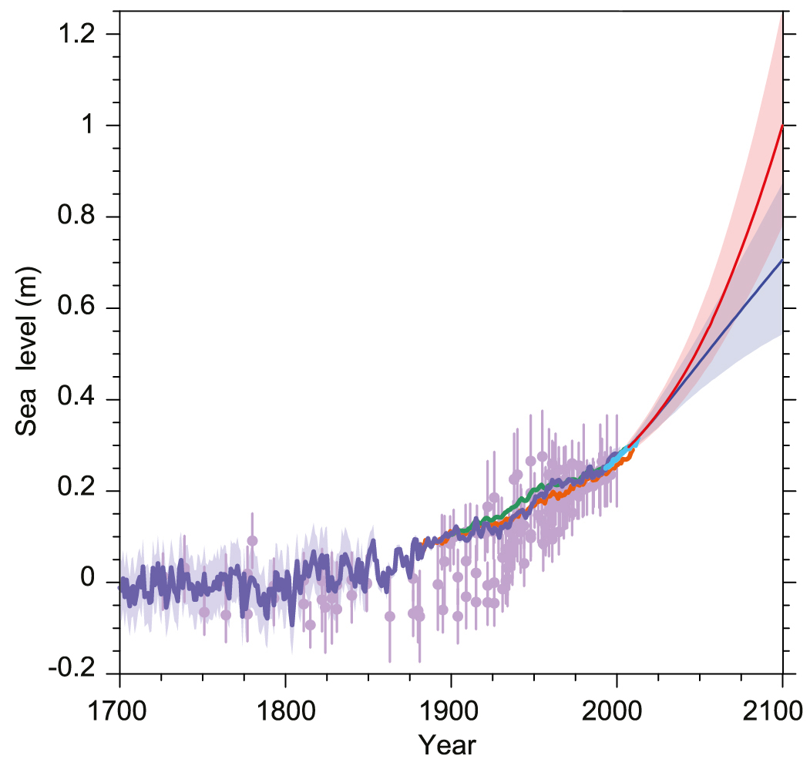

Slide 11
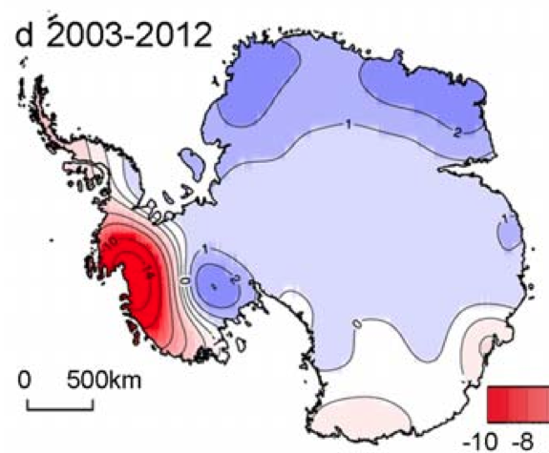
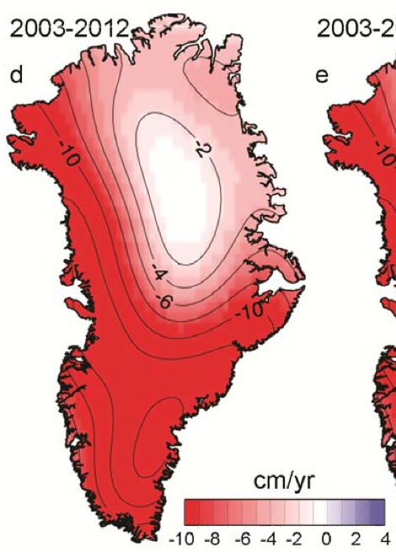
Mass change, ice sheets
(AR5 WG1 Figs 4.13d-4.14d)

Slide 12
Changes in Water and Ice
(AR5 WG1 FAQ2.1)

Slide 13
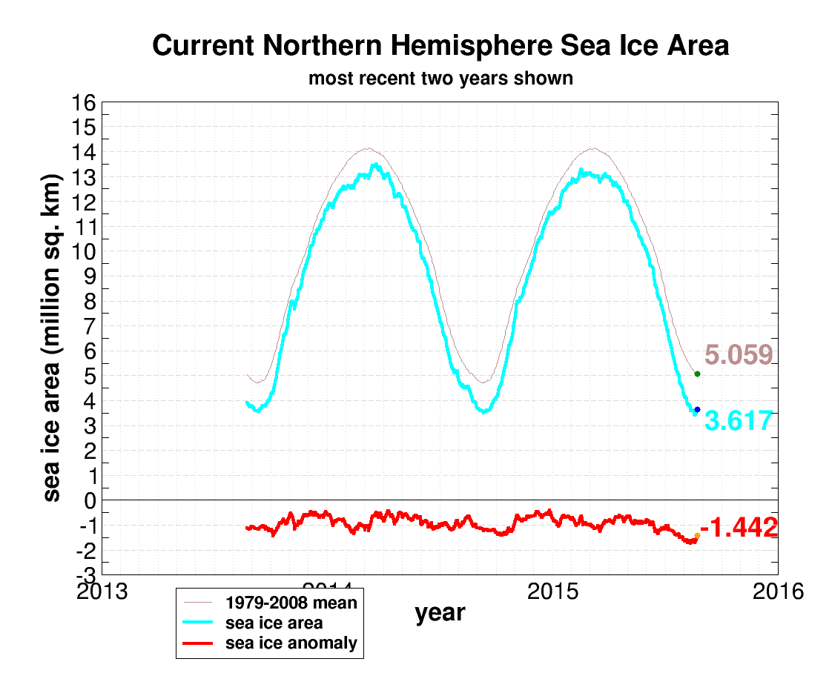

Slide 14
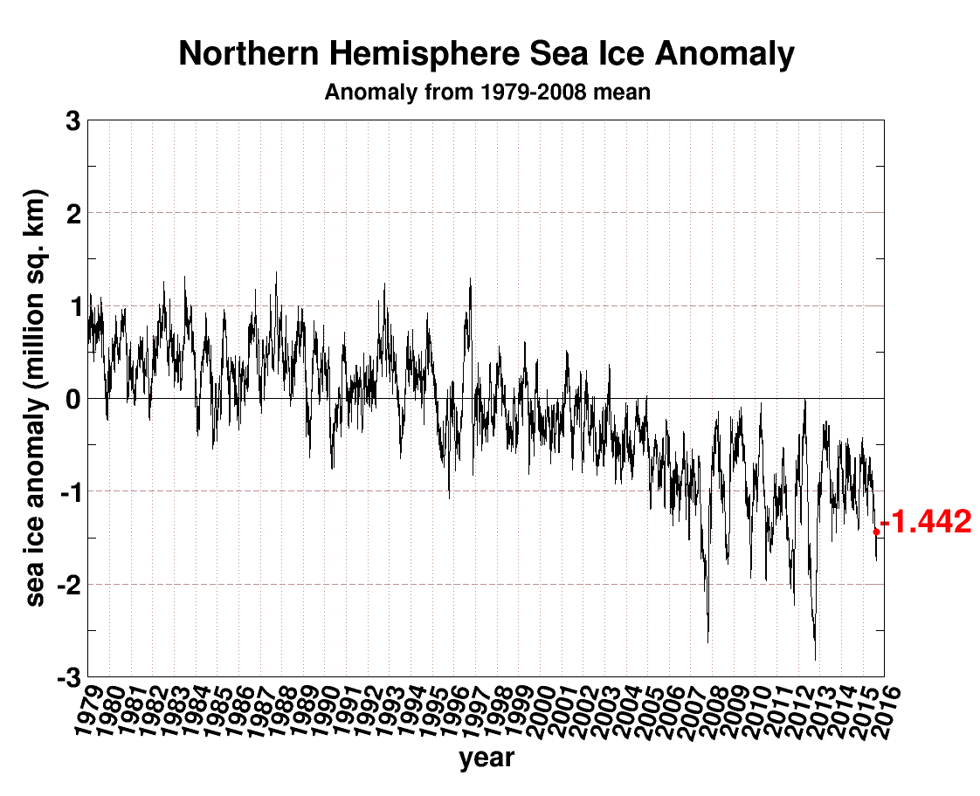

Slide 15
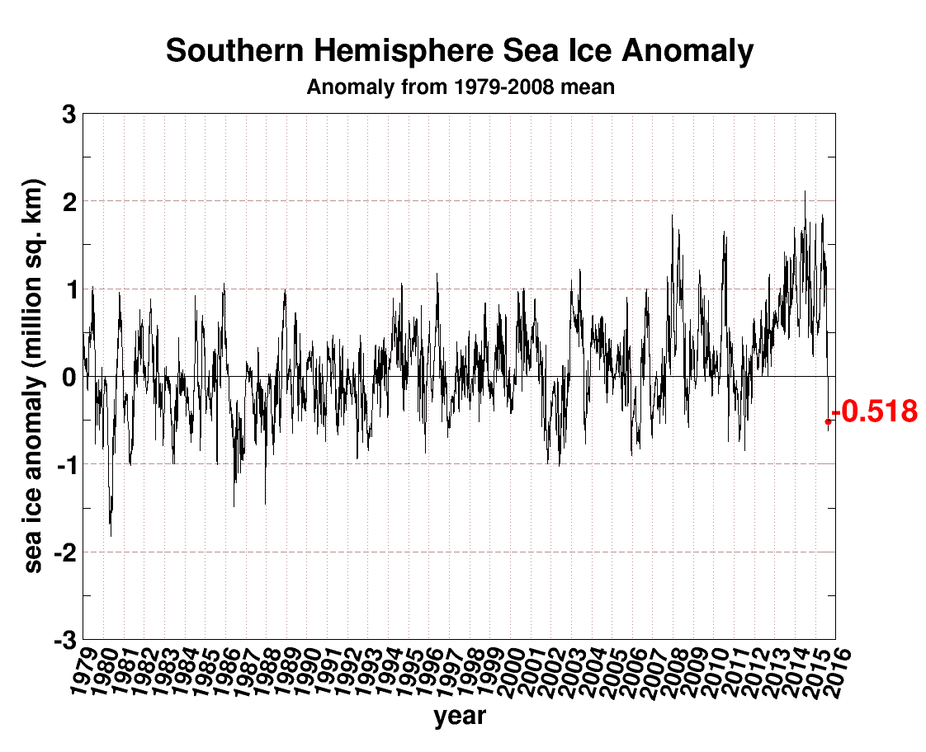

Slide 17
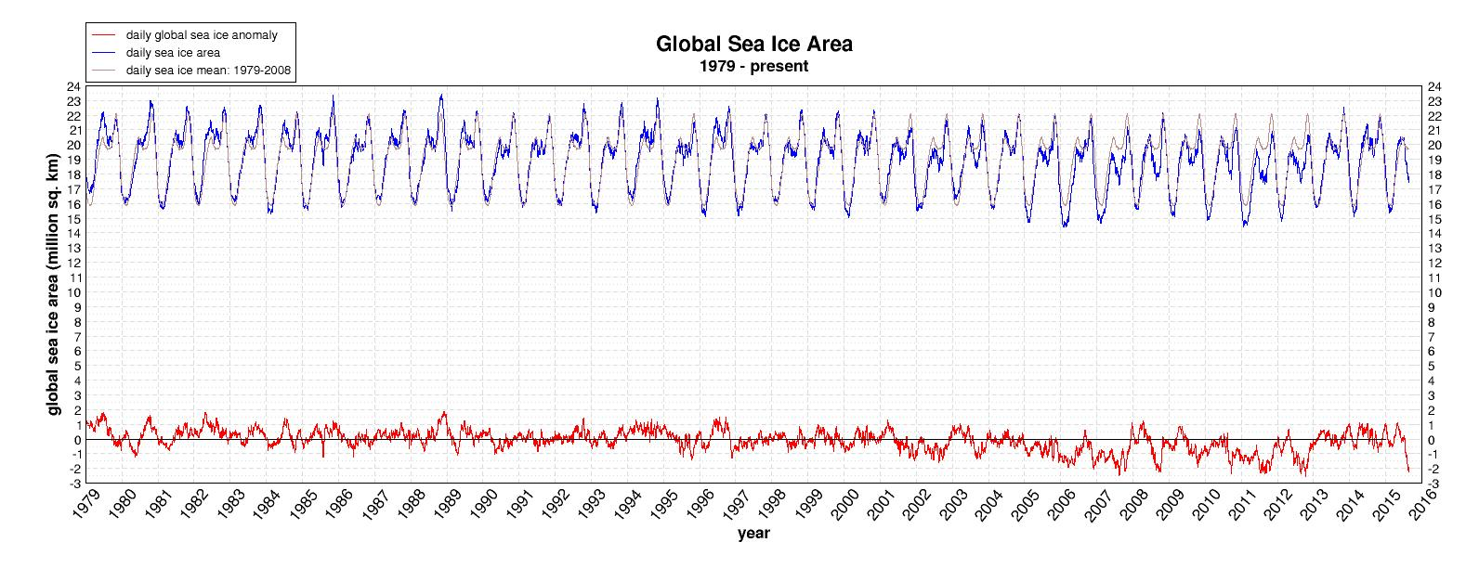

Slide 19
Global Energy Balance, Part 1
Sun
Atmosphere
Each arrow = 20 W/m²
Earth

Slide 20
Scientific Principles
Energy Imbalance implies a net gain or loss of energy
Typical annually averaged energy imbalances are << 1% of the energy flow

Slide 21
Global Energy Balance, Part 1
Sun
Atmosphere
Each arrow = 20 W/m²
Earth

Slide 22
Global Energy Balance, Part 1
Sun
Atmosphere
Each arrow = 20 W/m²
Earth

Slide 23
Global Energy Balance, Part 1
Sun
Atmosphere
Each arrow = 20 W/m²
Earth

Slide 24
Global Energy Balance, Part 1
Sun
Atmosphere
Each arrow = 20 W/m²
Earth

Slide 25
Global Energy Balance, Part 1
Sun
Atmosphere
Each arrow = 20 W/m²
Earth

Slide 26
Global Energy Balance, Part 2
Sun
Atmosphere
Each arrow = 20 W/m²
Earth

Slide 27
Global Energy Balance, Part 2
Sun
Atmosphere
Each arrow = 20 W/m²
Earth

Slide 28
Global Energy Balance, Part 2
Sun
Atmosphere
Each arrow = 20 W/m²
Earth

Slide 29
Global Energy Balance, Part 2
Sun
Atmosphere
Each arrow = 20 W/m²
Earth

Slide 30
Evolution of Estimated Forcings (AR5 WG1 Fig. 8.18)

Slide 31
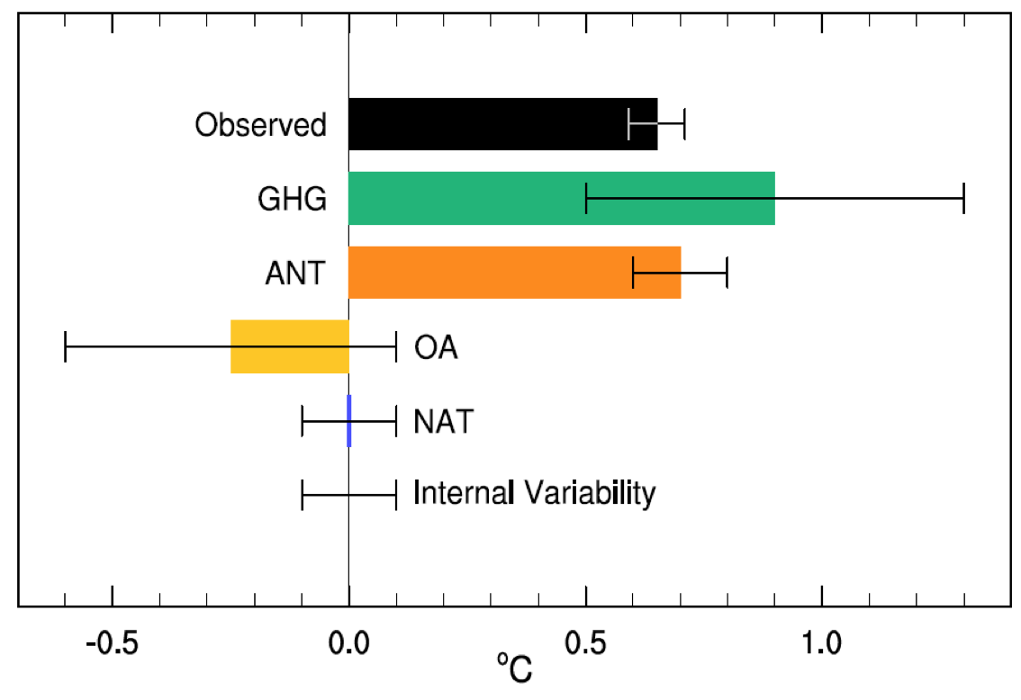
Mid-20th Century Attribution (AR5 WG1 Fig. 10.5)

Slide 32
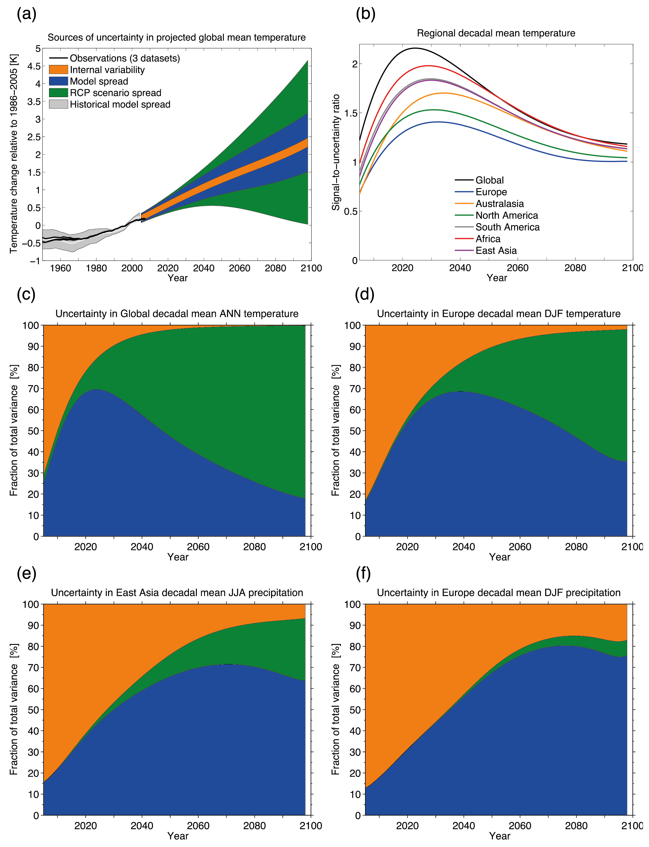

Slide 33
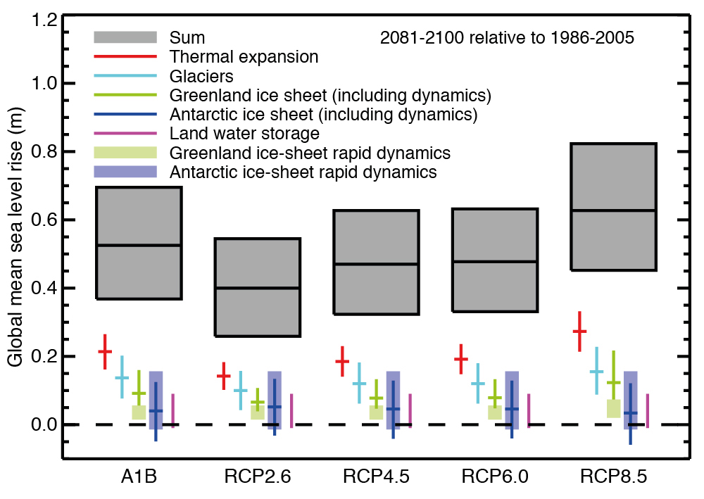

Slide 35
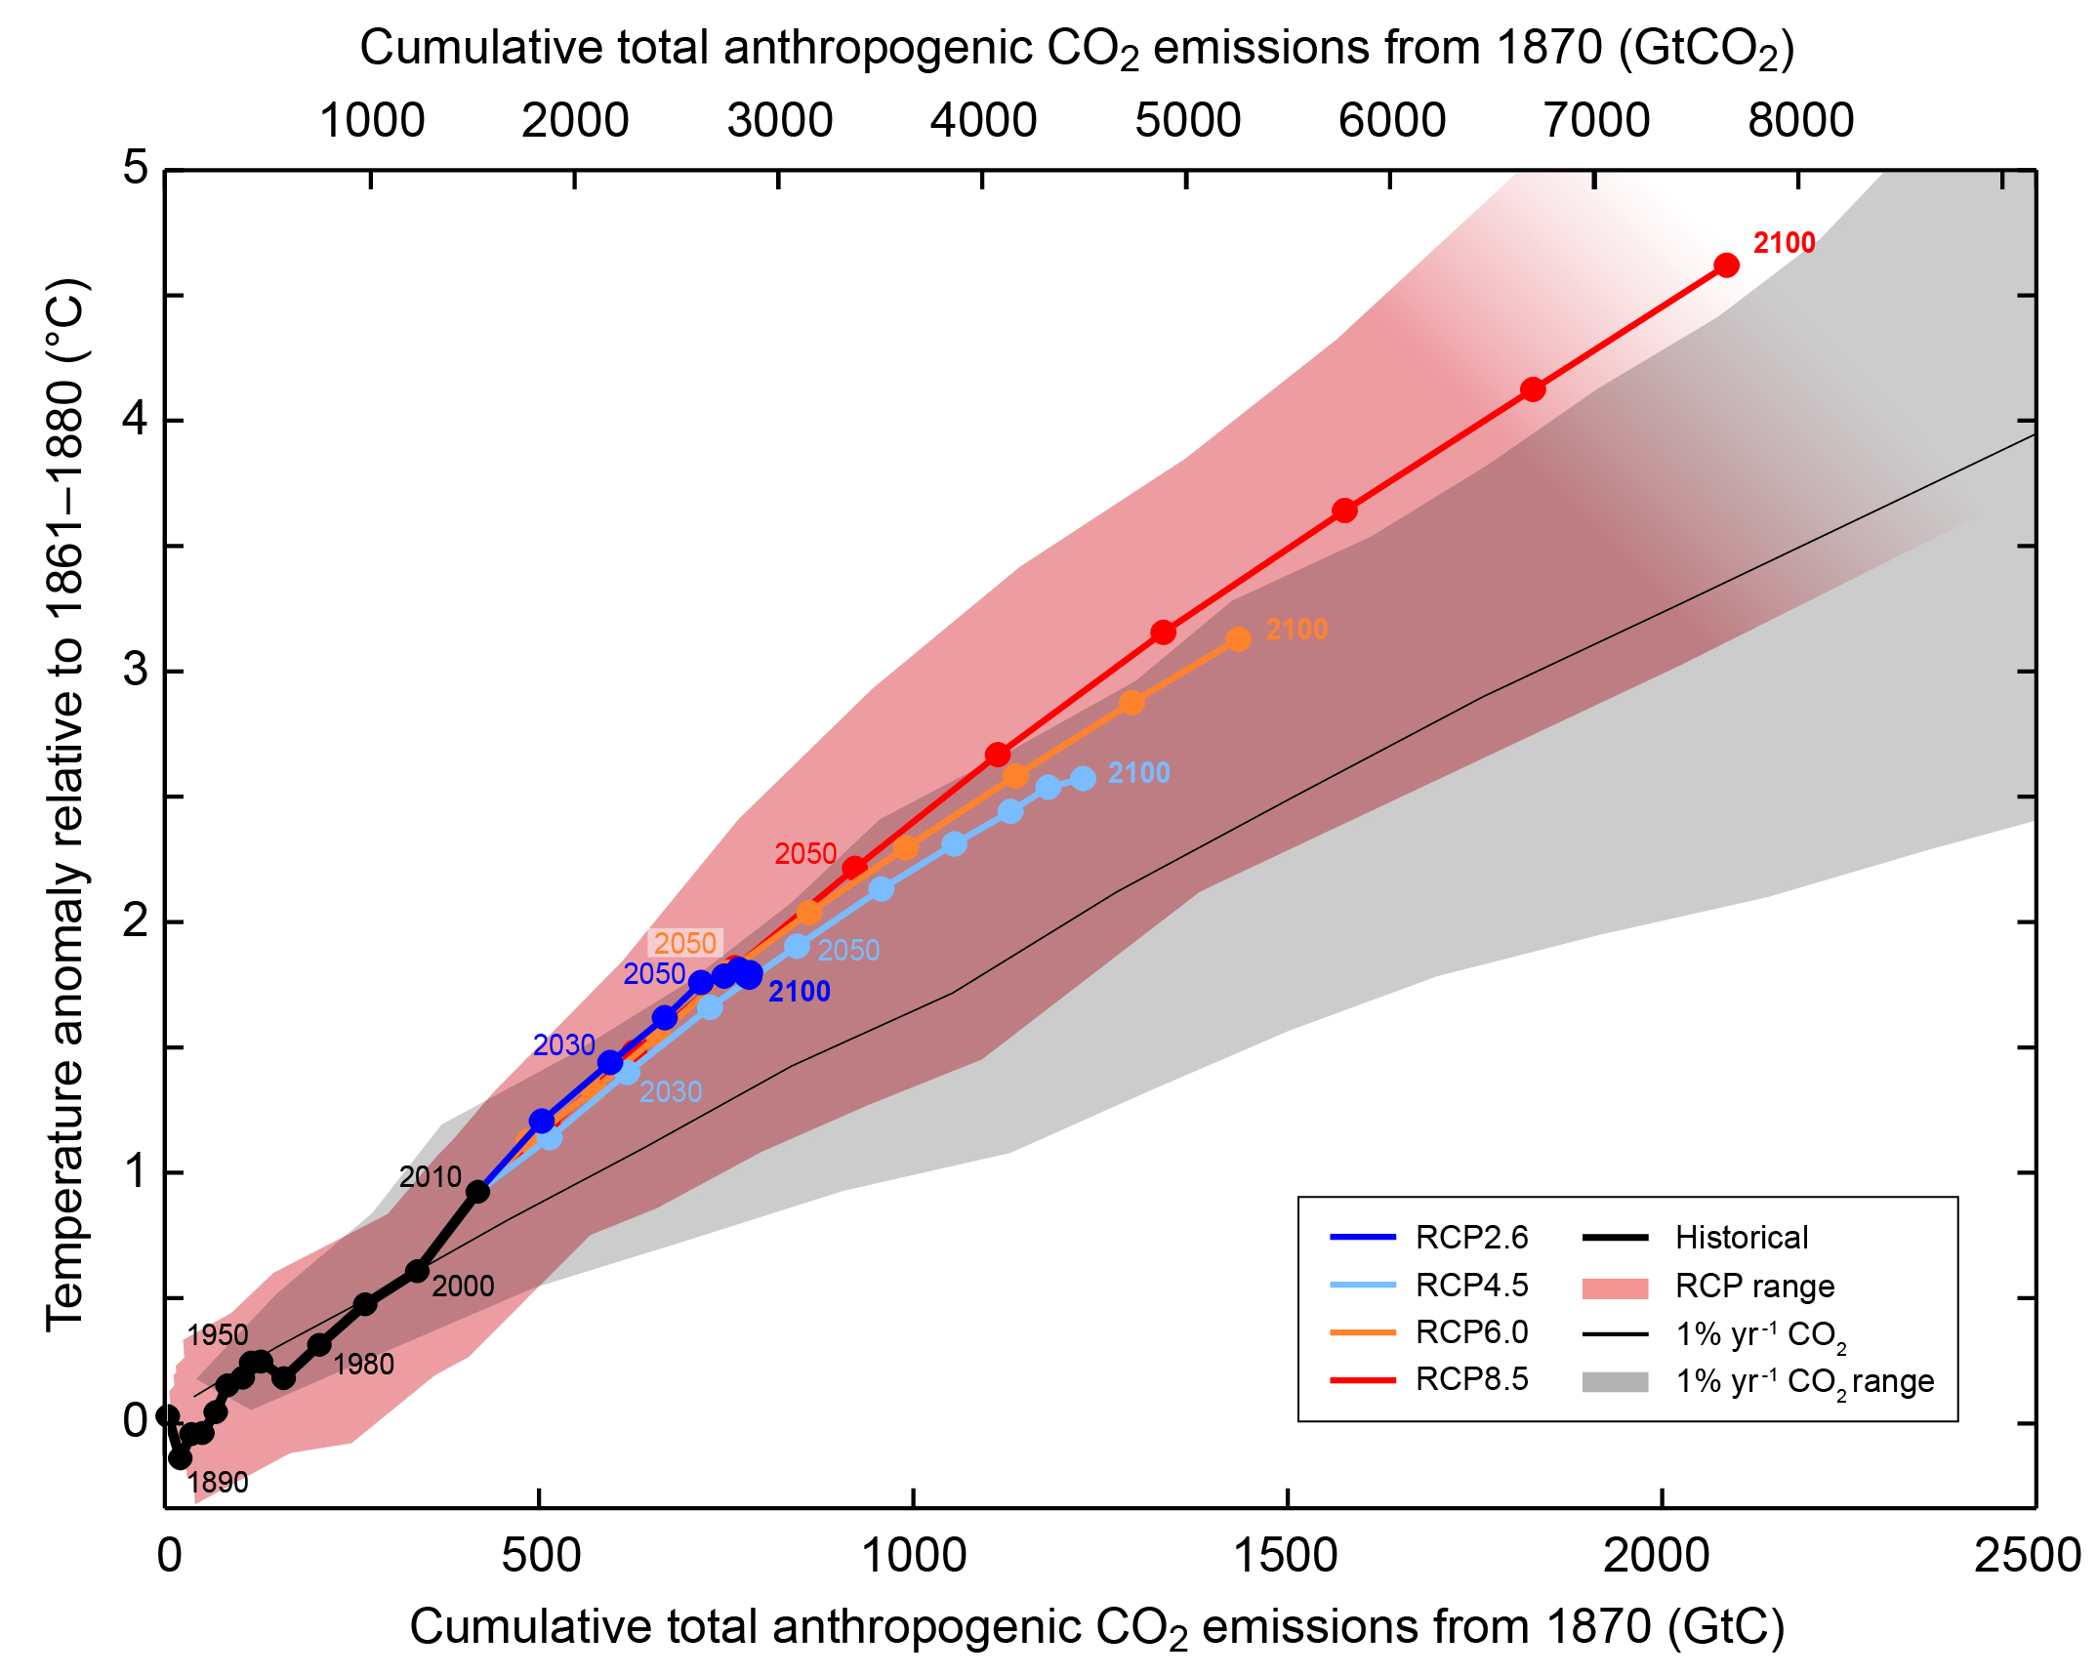

Slide 37
Changes in Precipitation/Storms
Precipitation
  NH midlatitudes: increase since 1901/1951
  Elsewhere: ???
Intense rainfall events
  Increase over many land areas
Drought
  Since 1950, some increases and some decreases, some increase overall?
Tropical cyclone activity
  Increase over past century?

Slide 38
Natural Variability

Slide 39
Climate Change

Slide 41
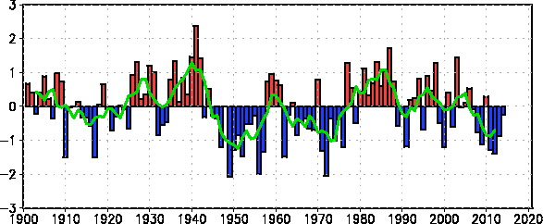

Slide 42
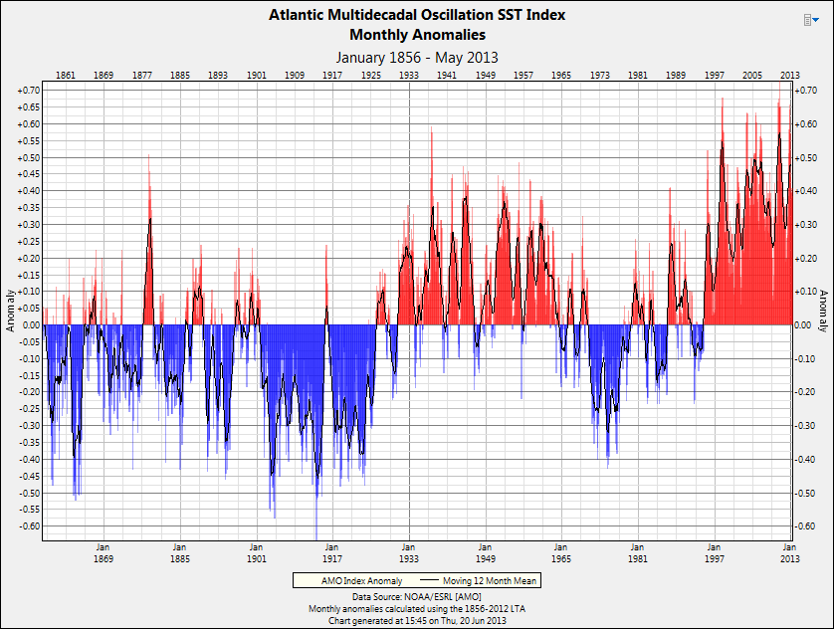

Slide 47
Summary
The climate is changing
Over the long haul, it’s us
Future changes are hard to pin down
Some impacts are easy
  It’ll get warmer
Some impacts are hard
  More droughts?
The scientists aren’t arguing over what you think they’re arguing over

Slide 48
Texas expectations
Over multiple decades, Texas will get warmer (1-2 °F by mid-century?)
For now, natural variability will continue to rule Texas precipitation
Streamflow changes: increased water use, increased evaporation
Largest impacts: bay/estuary ecosystems

Slide 49
Climate Change as Aggravating Factor
Water supply
Coastal subsidence
Endangered species
Wildfire
Agriculture
Ocean acidification
Population displacement

Slide 50
Contact Information
John W. Nielsen-Gammon
n-g@tamu.edu
979-862-2248
http://climatexas.tamu.edu
http://ClimateChangeNationalForum.org

