Slide 1
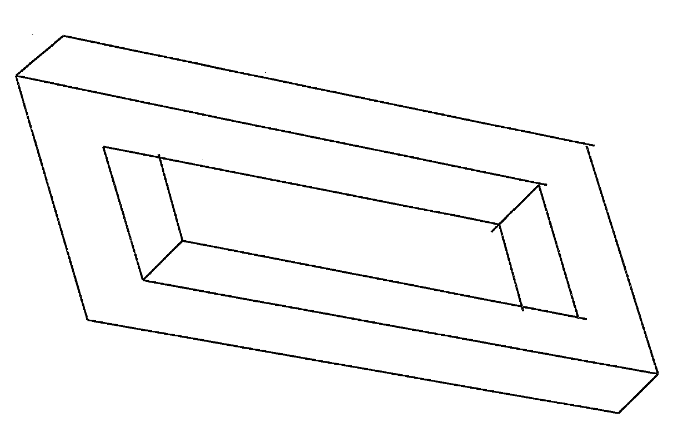

Slide 2
Advocacy Survey
Negotiation

Slide 3
Negotiation Dynamics
Win-Win
  Integrative or Cooperative
Win-Lose
  Integrative or Cooperative/Zero-Sum or Distributive
Lose-Lose
  Zero-Sum or Distributive

Slide 4
Negotiation Dynamics
Shark
Owl
Teddy Bear
Turtle
Fox

Slide 5
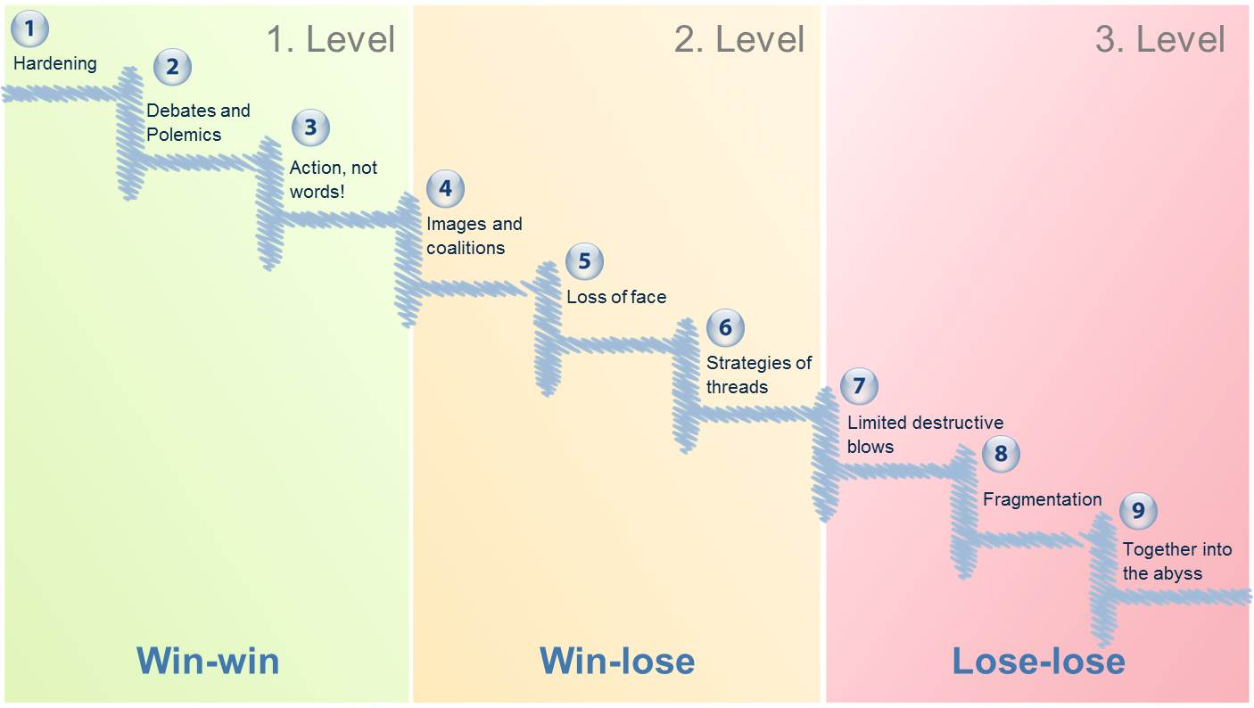
What It Means

Slide 6
Negotiation: Key Concepts
Preparation, preparation, preparation
  What do you know?
  What DON’T you know?
  Beware preparation bias…

Slide 7
Negotiation: Key Concepts
Barriers to Resolution
  Strategic Barriers
  Principal/Agent (Interests v. Incentives)
  Cognitive Barriers
    Risk aversion
    Loss aversion

Slide 8
Negotiation: Key Concepts
Bargaining Zone - ZOPA
Reservation Value
Best Alternative to a Negotiated Agreement or BATNA
Prioritized Interests
Logrolling
Never give anything away for free

Slide 9
5 Rules of T.H.U.M.B
For Every Successful Negotiator To Remember
T – There are no “give-aways” in negotiation.
H – Help me help you.
U – Understand yourself.
M - Make justifiable demands and concessions.
B - Be curious

Slide 10
T
There are no “give-aways” in negotiation
As you prepare for your negotiation, you will place value on, and prioritize, your negotiable items. They will generally fall into 3 categories:
  Highest priority. These items have the highest value and are the most valuable to your client.
  Medium priority. These items are “flexible”, meaning you can mix-and-match them to best fit your negotiation strategy.
  Low priority. The items have the lowest value to your client.

Slide 11
T
There are no “give-aways” in negotiation
The temptation is to give away the lowest priority items – and get nothing in return for them. Remember, just because an item doesn’t have much value to you, doesn’t mean it won’t have a HIGH value to the other party.

Slide 12
H
Help me help you
In a negotiation, you have to know what the other party wants. Once you know their interests, you can use that information to create an “expand the pie” approach to the negotiation process.

Slide 13
H
Help me help you
How do you accomplish this?
  You have to “sell your vision” for the outcome of the negotiation.
  You have to actively engage with the other party.
  You have to learn how to ask information-gathering questions.
  You have to be flexible.

Slide 14
U
Understand Yourself
To be a successful negotiator, you have to know yourself. What are your negotiating strengths? What are your negotiating weaknesses? What is your tolerance for risk?

Slide 15
U
Understand Yourself
How do you learn about your “negotiating” self?
  Fill out a series of assessments.
  Pay attention to how you respond in everyday negotiations.
  Learn about different negotiating styles.
  The only “negative” attribute is one you don’t know about.

Slide 16
M
Make justifiable demands & concessions
Successful negotiators have credibility. You gain credibility by being reasonable. One aspect of being reasonable is that you can justify each concession that you make.

Slide 17
M
Make justifiable Demands & concessions
What is a justifiable demand?
  If you are negotiating for a salary increase, you need to be able to justify the reasons you deserve it. The more objective data you have to support your request, the more likely you are to get it.
What is a justifiable concession?
  If you make a move away from your opening offer/demand in a negotiation, you need to be able to explain the reasons you are willing/able to make that move.

Slide 18
B
Be Curious
When you prepare for a negotiation, you develop a bias (or several) that create the frame through which you approach your negotiation. If you don’t stay curious, the bias will lead you to assumptions that could end up creating blind spots for you in the negotiation process.

Slide 19
B
Be Curious
How do you stay curious?
  Keep asking yourself “what don’t I know?”
  Understand that you can only know what the other party wants by asking. Everything else is a projection of what you think they want.
  Ask questions that begin with “I’m curious…”

